Slide 1

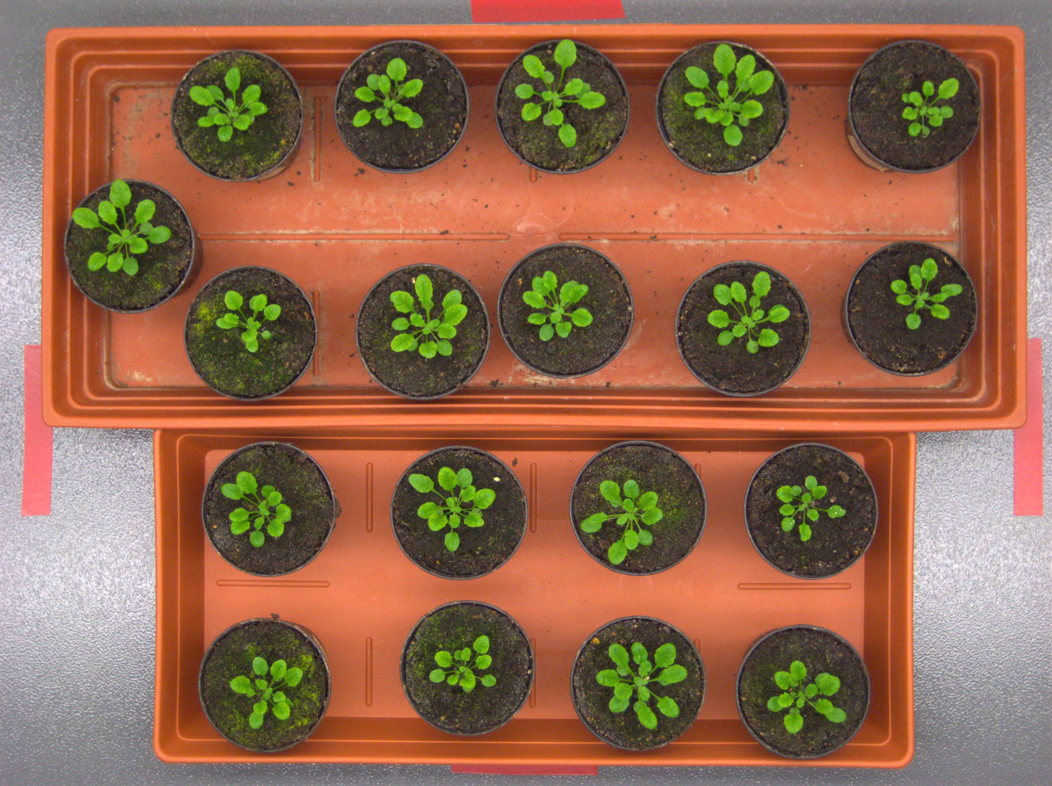
Plant Phenotype Analysis
Group E

Slide 2
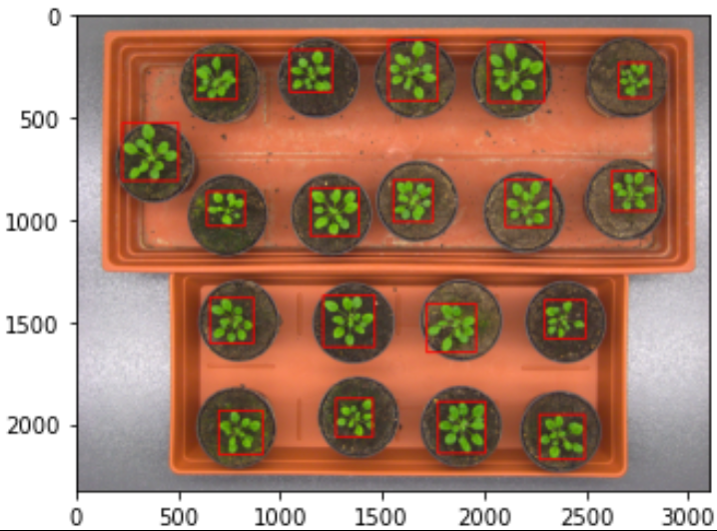
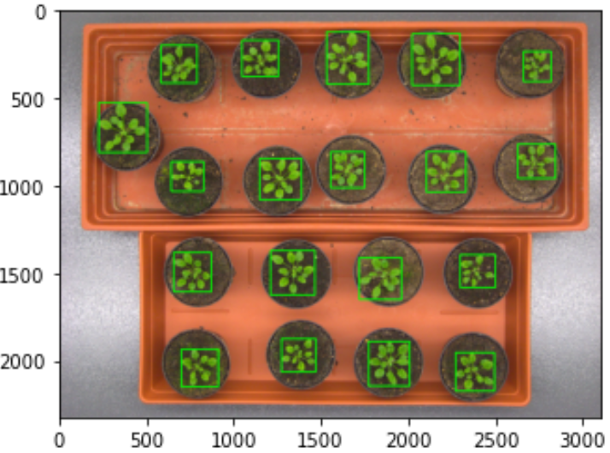
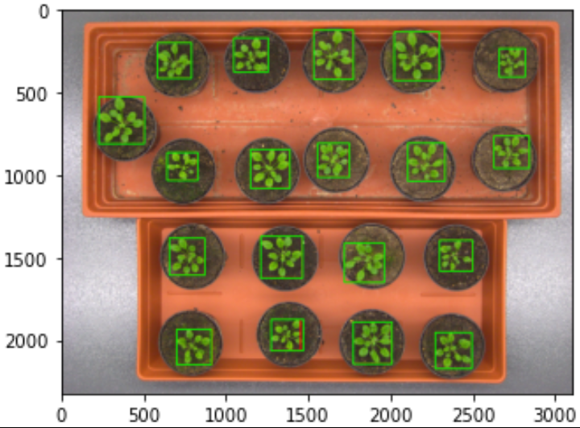
Task 1 – Plant localization
Pre-processing:
Covert image into LAB colour Space
Feature Extraction:
Separate plant from background using a threshold. Plant is green, background is not
Generate regions using contours and edge detection
Use region merging with boundary boxes
Evaluation:
Normalize image
Use Average Precision to evaluate algorithm: TP/(TP + FP)
Ground truth
Generated
Overlayed

Slide 3
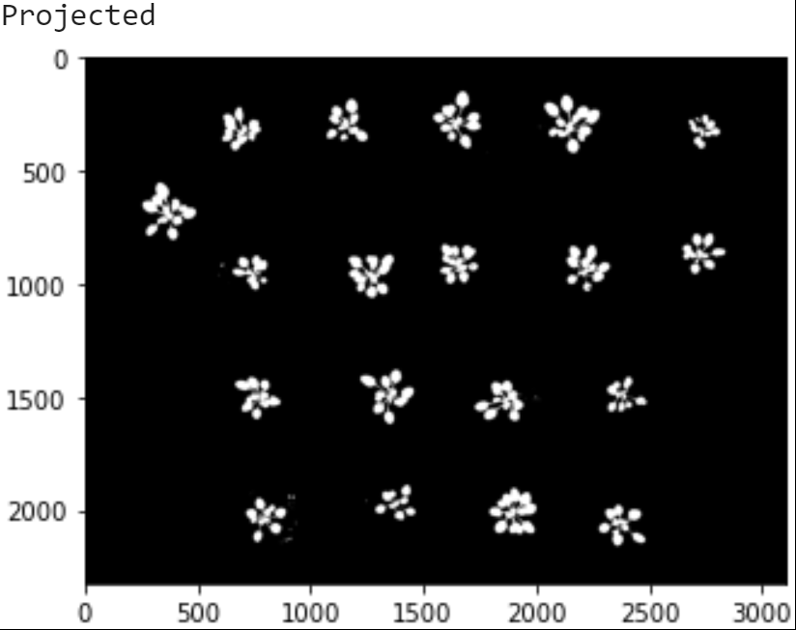
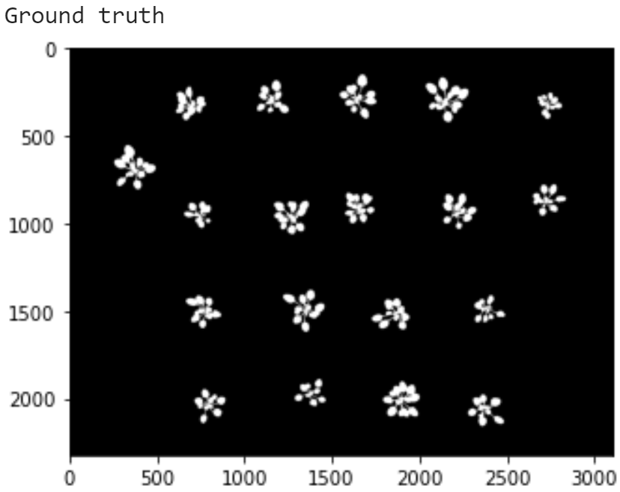
Task 2 – Projected Leaf Area
Pre-processing:
Covert image into LAB colour Space
Feature Extraction:
Separate plant from background using a threshold. Plant is green, background is not
Evaluation:
Normalize image
Use Dice Similarity coefficient to evaluate algorithm: (2*TP)/(2*TP + FP + FN)
Use Intersection over Union to evaluate algorithm: TP/(TP+FP+FN)

